Slide 1

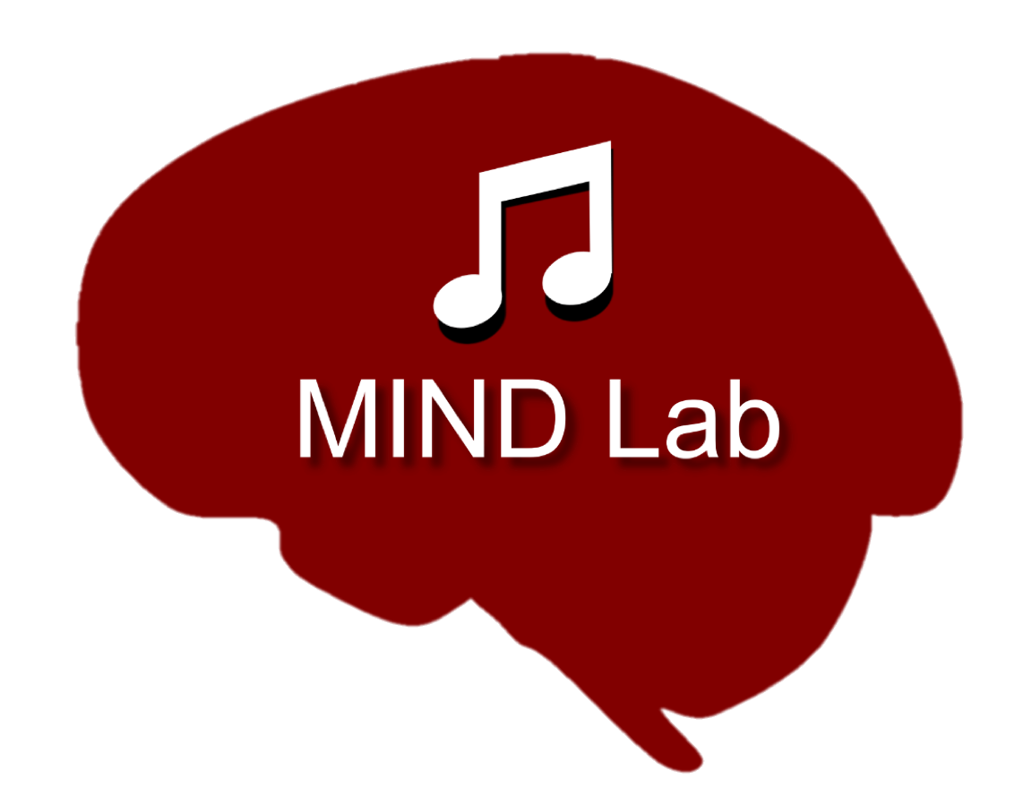
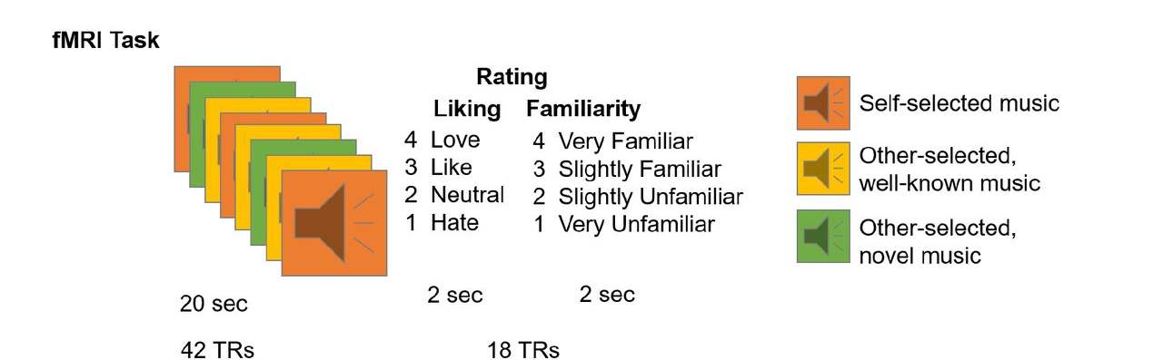
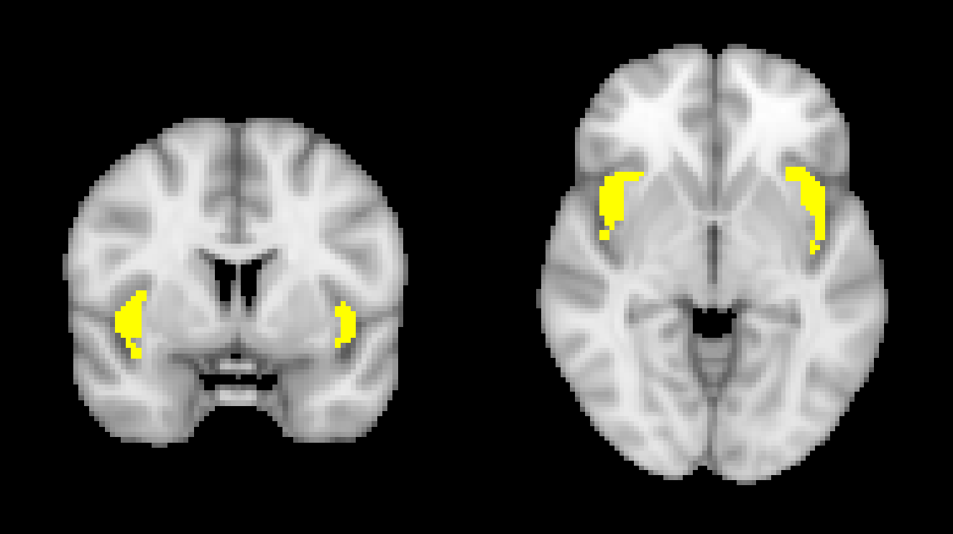
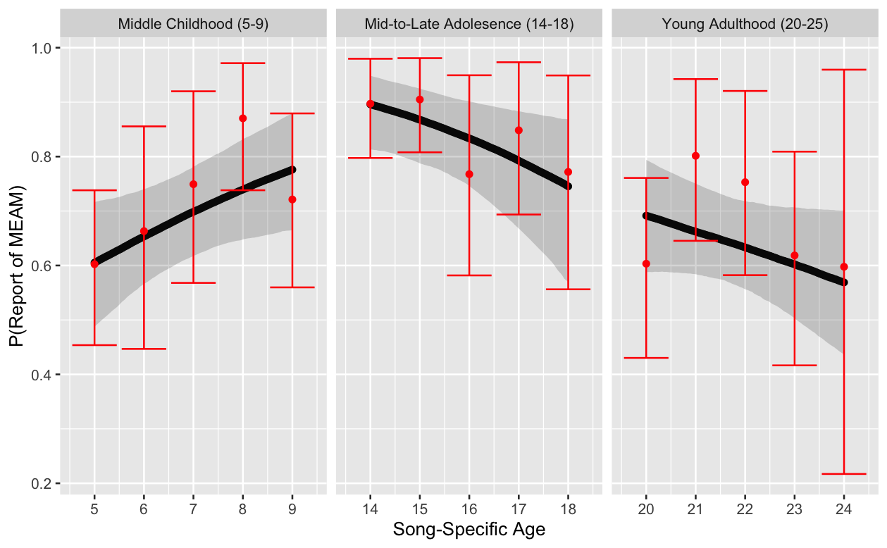
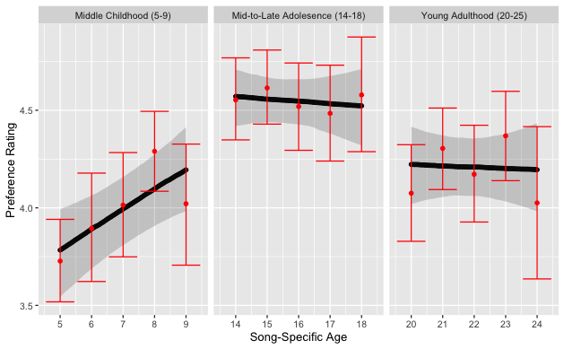
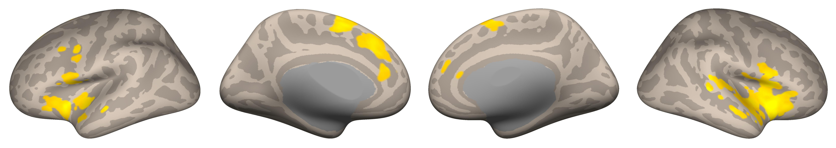
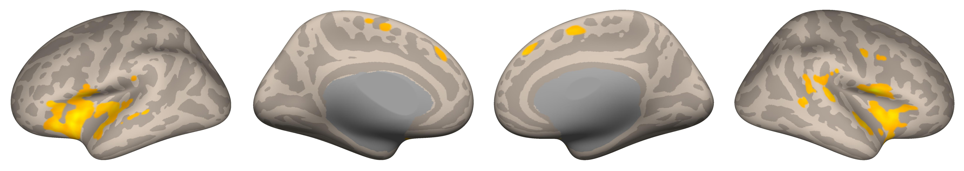
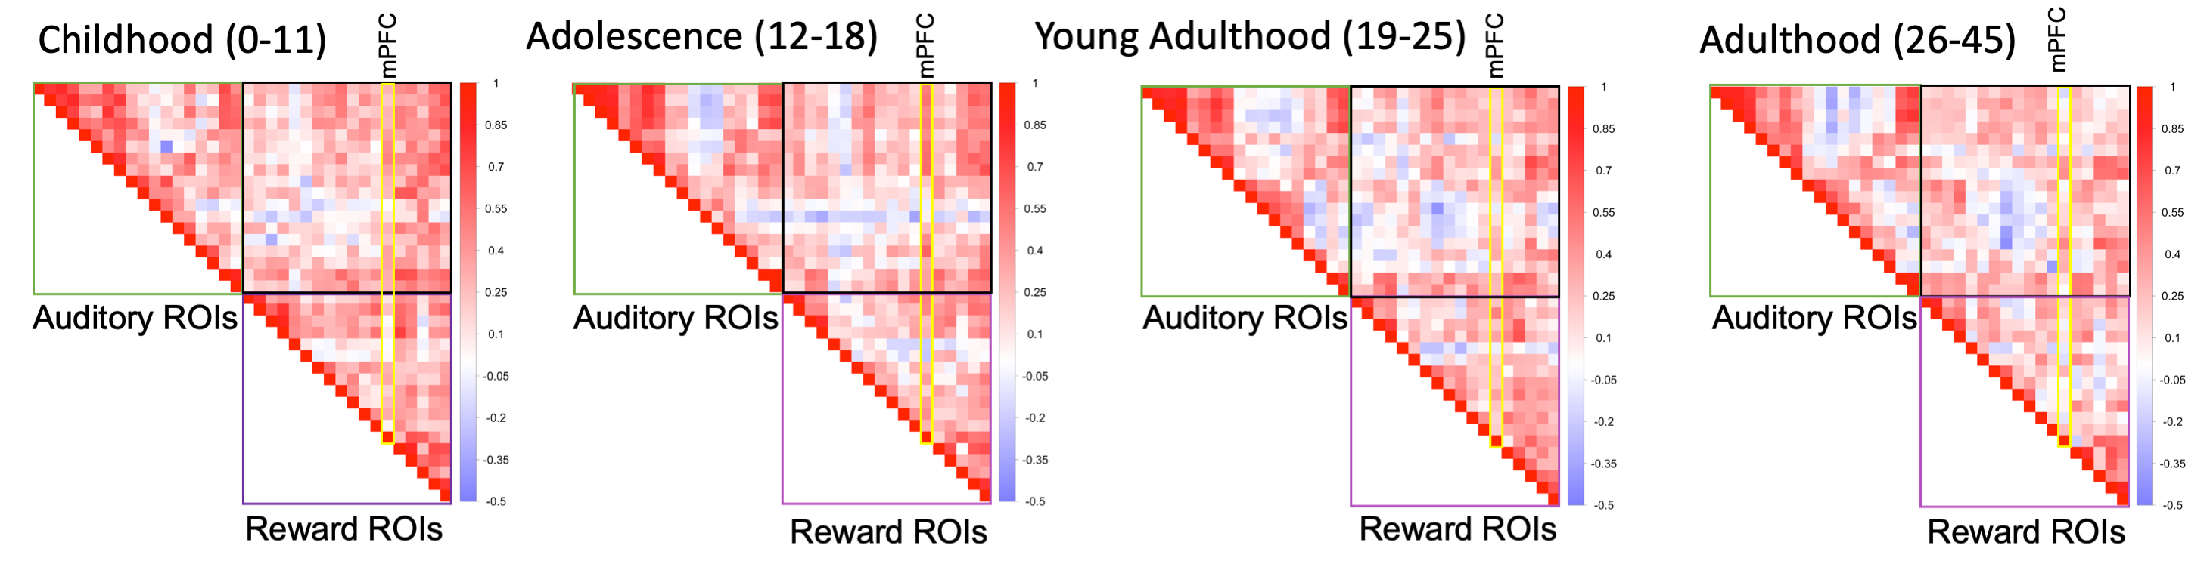
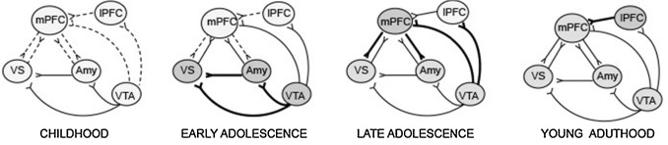
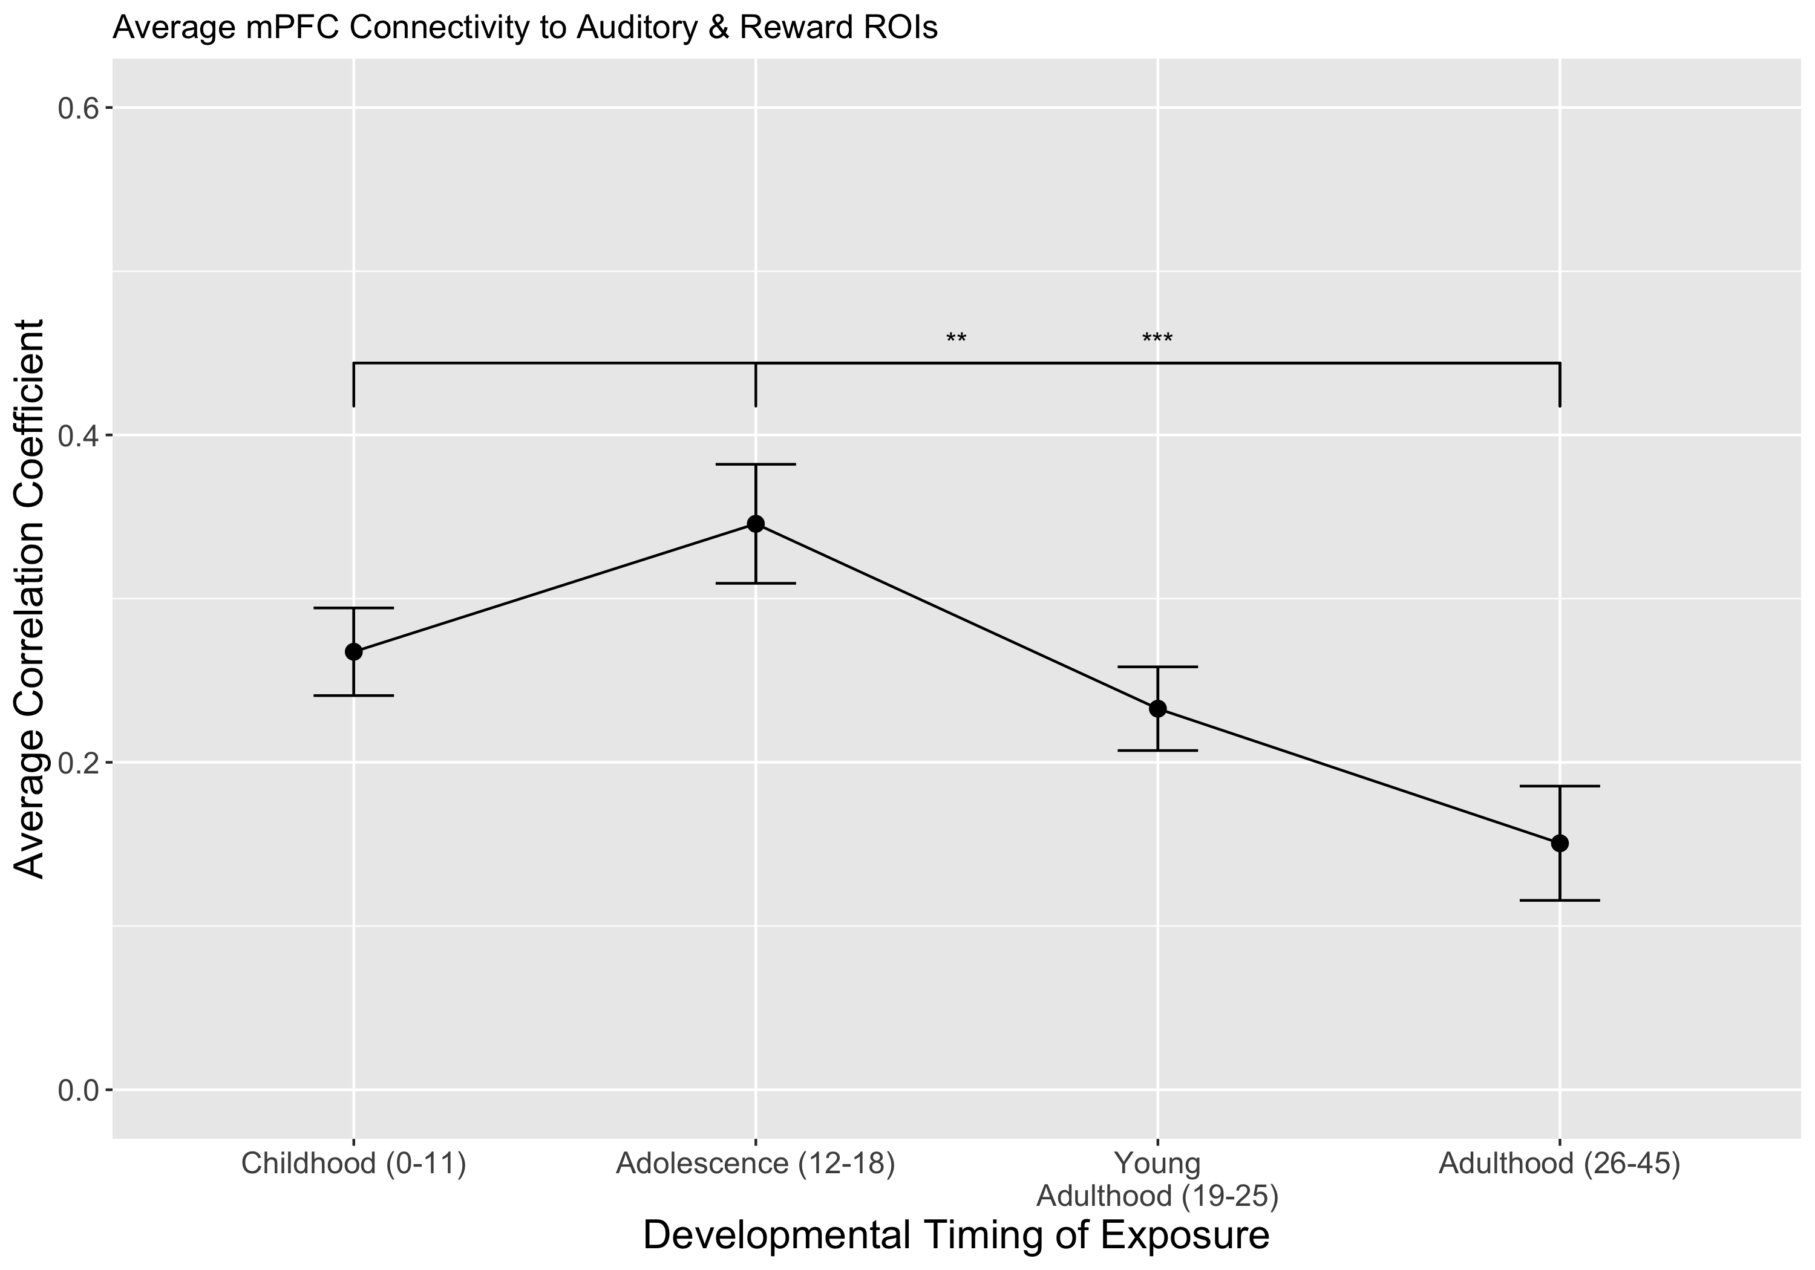
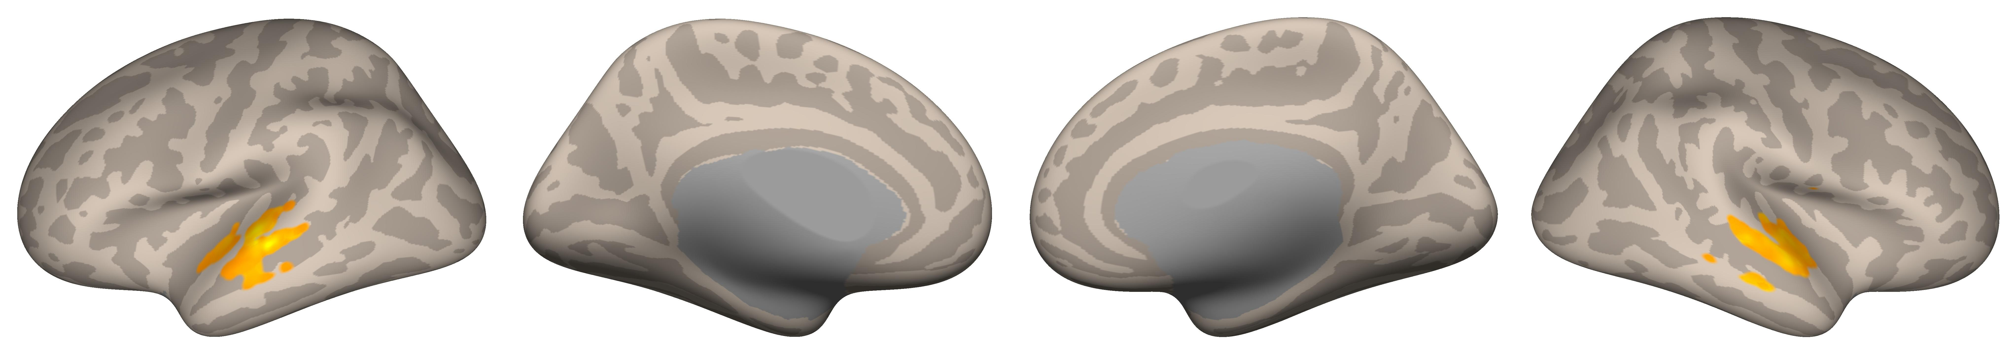
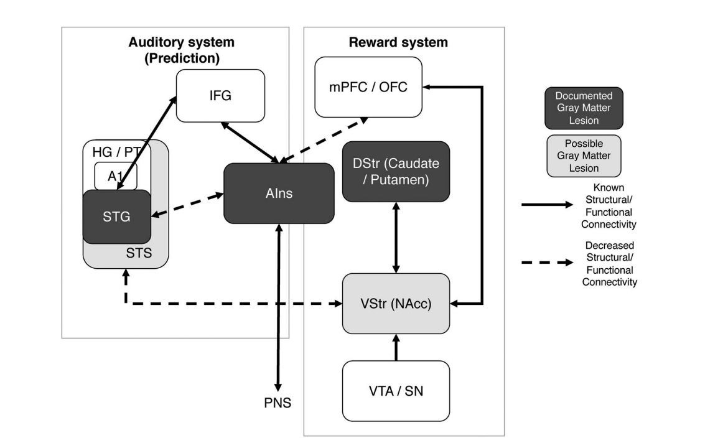
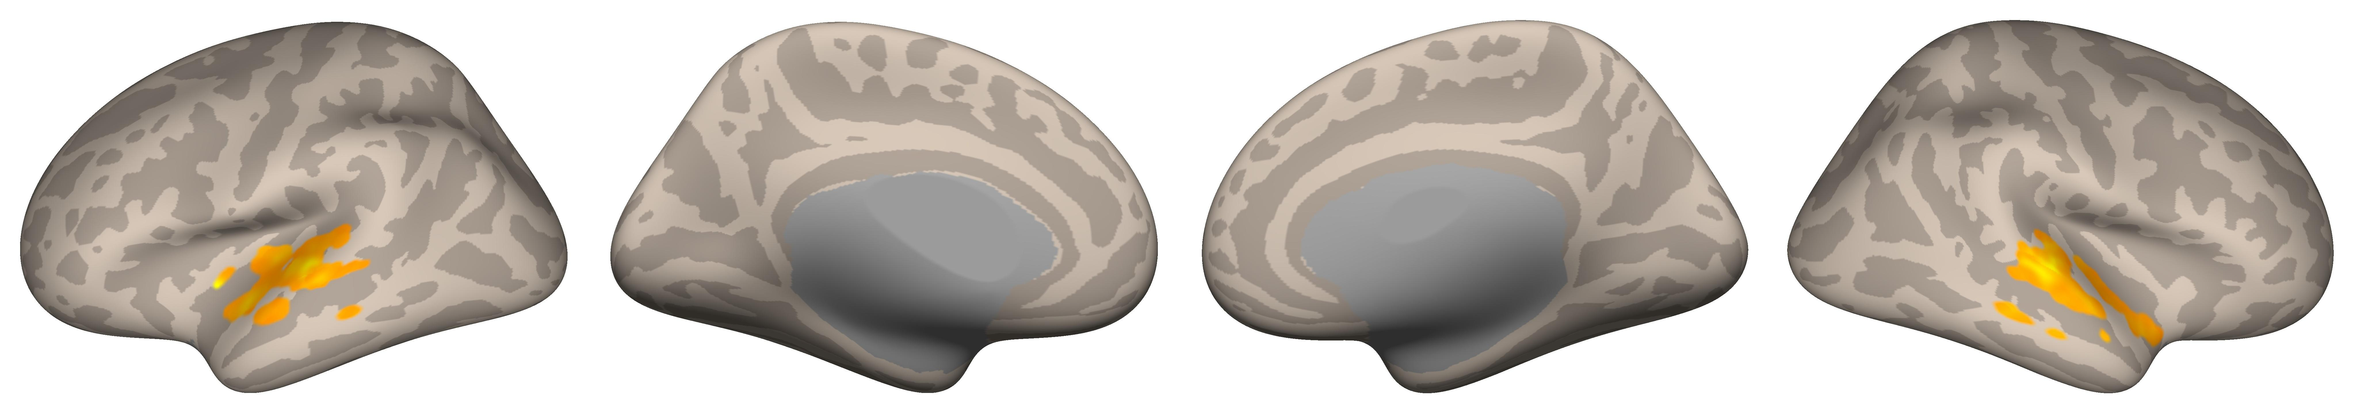

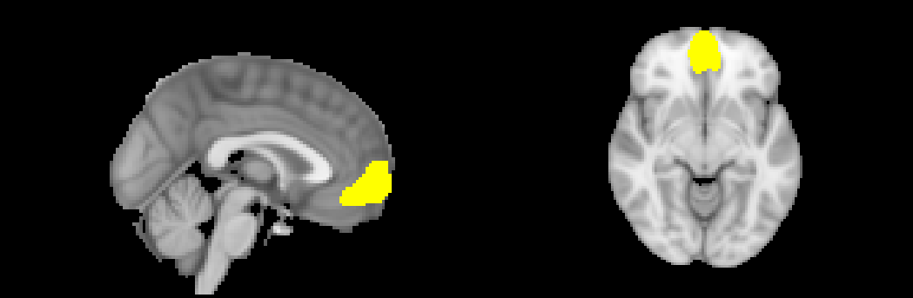
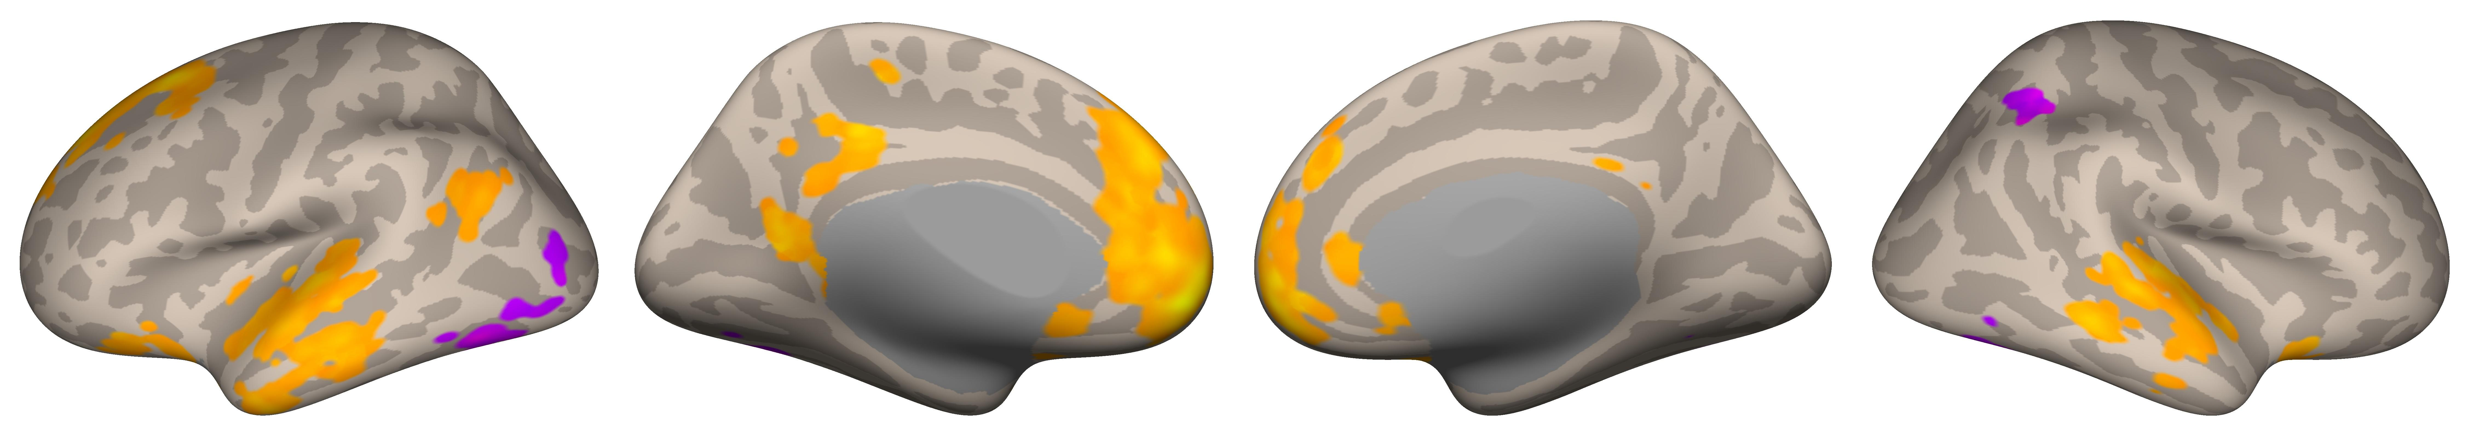
When You Heard it First: Age of Exposure Affects Functional Connectivity between Auditory and Reward Networks
Nicholas Kathios¹, Milena Aiello Quinci¹, Psyche Loui¹
¹Northeastern University
Background
Methods
Whereas both childhood and adolescent music elicited functional connectivity with auditory areas (STG, Heschl’s Gyrus), childhood music displayed connectivity with dorsal striatum (Putamen), adolescent music did so with the ventral striatum (Nucleus Accumbens)
Music encoded during adolescence may differ in its functional connectivity patterns from that outside this time period, providing neuroscientific insight into the reminiscence bump effect & development of lifelong preferences
Lifelong preference may reflect improved reward learning in adolescence that persists across the lifespan
Development of the social brain in adolescents may also account for these effects, consistent with the Music for Social Bonding hypothesis⁶
Future Directions: Cross-sectional & longitudinal music-listening fMRI studies; investigation of age-related differences on music reward-learning paradigms; SSA fMRI analyses in clinical populations
Rubin, D. C., & Schulkind, M. D. (1997). The distribution of autobiographical memories across the lifespan. Memory & Cognition, 25(6), 859–866. https://doi.org/10.3758/BF03211330
Casey, B. J., Getz, S., & Galvan, A. (2008). The adolescent brain. Developmental Review, 28(1), 62–77. https://doi.org/10.1016/j.dr.2007.08.003
Steinberg, L., Albert, D., Cauffman, E., Banich, M., Graham, S., & Woolard, J. (2008). Age differences in sensation seeking and impulsivity as indexed by behavior and self-report: Evidence for a dual systems model. Developmental Psychology, 44(6), 1764–1778. http://dx.doi.org/10.1037/a0012955
Casey, B., Galván, A., & Somerville, L. H. (2016). Beyond simple models of adolescence to an integrated circuit-based account: A commentary. Developmental Cognitive Neuroscience, 17, 128–130. https://doi.org/10.1016/j.dcn.2015.12.006
Belfi, A. M., & Loui, P. (2020). Musical anhedonia and rewards of music listening: Current advances and a proposed model. Annals of the New York Academy of Sciences, 1464(1), 99–114. https://doi.org/10.1111/nyas.14241
Savage, P. E., Loui, P., Tarr, B., Schachner, A., Glowacki, L., Mithen, S., & Fitch, W. T. (2021). Music as a coevolved system for social bonding. Behavioral and Brain Sciences, 44. https://doi.org/10.1017/S0140525X20000333
We acknowledge support from Grammy Foundation, NSF-CAREER 1945436, NSF-STTR 2014870, and Kim and Glenn Campbell Foundation.
Anterior Insula Seed-Based Connectivity
Older adults tend to recall a disproportionately high number of autobiographical memories from their adolescence and young adulthood compared to any other time across the lifespan (the “reminiscence bump”)¹
Not only does this population recall more autobiographical memories in response to music from their adolescence compared to music outside this time period, but also show lifelong preferences for music from this time:
This suggests that age of encoding plays an important role in not only in forming memories in response to music, but also in forming lifelong preferences
Adolescents display increased sensitivity to reward and risky behavior, which has been attributed disproportionate maturation of subcortical limbic regions in comparison to frontocortical regions^{2,3}
Connections between the mPFC and VStr strengthen during this time period (particularly in late adolescence), with the mPFC regulating limbic responses as individuals mature:⁴
Pleasurable music listening experiences involves an interaction between and within the auditory and dopaminergic reward systems, facilitated by the anterior insula:⁵
Taken together, these models suggest increased preference for music from one’s adolescence might, in part, reflect increased connectivity between the mPFC and VStr that persists across the lifespan
Hypothesis: Music first heard in listeners’ adolescence will show functional connectivity patterns between the mPFC and reward circuitry (namely, VStr)
18 cognitively healthy older adults (ages 54-89; M=66.6)
10/18 participants completed a follow-up interview in which they reported when they thought they first heard both self- and other-selected clips
We included every self-selected stimuli and any other-selected stimuli rated a 4 (“Very Familiar”) in our analyses
To bin each stimulus via developmental exposure (childhood [0-11], adolescence [12-18], young adulthood [19-25], and adulthood [26-45]), we subtracted the year in which the participant was born from the year in which the stimulus was first released (Song-Specific Age)
We utilized participants’ self-report for self-selected music from before they were born
Music music first heard during adolescence and young adulthood showed greater activation in auditory areas (STG, MTG, Heschl’s Gyrus)
Music music first heard during adolescence showed functional connectivity with auditory (MTG, STG) and reward areas (ventral & dorsal striatum, insula, orbitofrontal cortex)
Childhood (0-11):
Adolescence (12-18):
Voxel Threshold: p-FDR corrected <0.05; Cluster Threshold: p FDR-corrected <0.05
Music from young adulthood (19-25) and adulthood (26-45) did not survive corrections
ROI-ROI Connectivity Matrices
Univariate Main Effect of Age of Exposure
Adolescence (12-18)
Young Adulthood (19-25)
Discussion
Voxel Threshold: p-FDR corrected <0.05; Cluster Threshold: p FDR-corrected <0.05
Music from childhood (0-11) and adulthood (26-45) did not survive corrections
mPFC Seed-Based Connectivity
Adolescence (12-18):
References
Voxel Threshold: p-FDR corrected <0.05; Cluster Threshold: p FDR-corrected <0.05
Music from childhood (0-11), young adulthood (19-26), and adulthood (26-45) did not survive corrections

